Slide 1
Respiratory season…yeah!
Kathleen Adelgais, MD MPH
Children’s Hospital Colorado

Slide 3
Case Example
14 month old with 4 day history of cough, congestion, and fever of 101 who presented to PCP office
EMS arrival:
Pt is tired and receiving O2 via NRB blow by mask
What is the diagnosis???
Breath Sounds
Cough
What is the treatment???

Slide 4
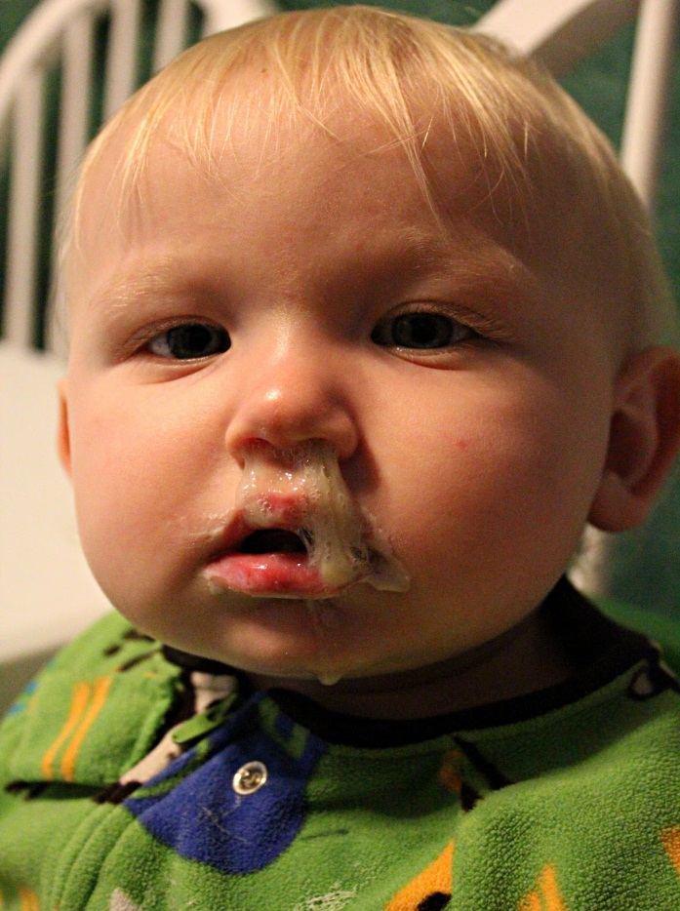
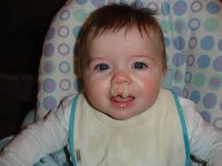
Bronchiolitis
Signs/symptoms
Runny nose
Coughing/sneezing
Tachypnea
Retractions
Wheezing/crackles
Dehydration due to decreased oral intake
Apnea: particularly in the young, hx of prematurity
Fever
Notes:
Snot factories

Slide 5
Lower Airway- Bronchiolitis
Acute viral infection- most commonly RSV
Symptoms are worsen for the first 3-5 days
Infectious process → destruction in lining of bronchioles
Bronchoconstriction
Mucous plugging
Notes:
Obstruction from bronchoconstriction and mucous plugging
Extensive plugging→ atelectasis and pneumonia
Problem= snot factory
Get worse before they get better
Breathing is a chore! Feeding is even worse. Esp for those obligate nose breathers. Viscous cycle!!!!!!!!!!!!!
Important for us to teach parents to sx right before feeding!
Lot of crackles, little bit of wheeze vs asthma which is a lot of wheeze, little bit of crackles

Slide 6
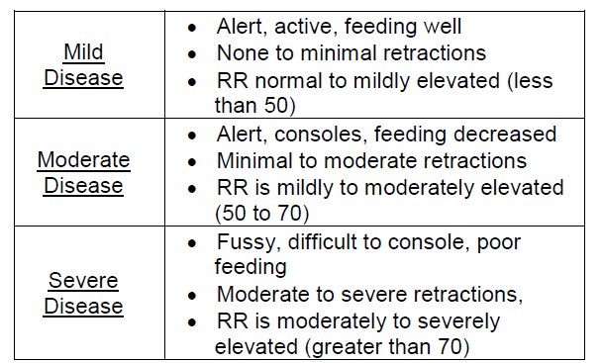
Severity Classificaiton

Slide 7
Bronchiolitis Treatment
Suction
Suction
Suction
Oxygen
Fluids
Nebs???-not unless they are over 2 years of age

Slide 8
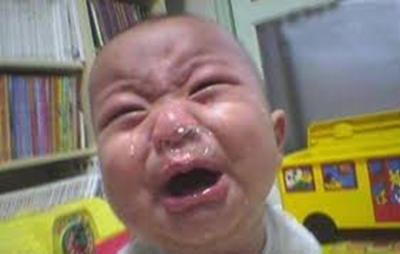
Basic Needs: Suction
Mushroom Aspirator

Slide 9
Next Case…
14 month old male with cough and fever, mom thinks he is going to stop breathing.
What is the diagnosis???
Breath Sounds
Cough
What is the treatment???

Slide 10
Croup
Most common cause of stridor in children
Epiglottitis is EXTREMELY RARE-particularly in vaccinated children
Child will have stridor, barky cough, and URI symptoms of sudden, often nocturnal onset
Most often seen in toddler age
Older children at higher risk for bacterial tracheitis which can mimic croup
Agitation worsens the stridor and respiratory distress

Slide 11
Treatment of Croup
For patients with severe stridor or stridor at rest: Nebulized Epinephrine
Options:
Racemic epinephrine: 0.5 mL of 2.25% solution via nebulizer diluted to 3 mL with saline
OR
1:1000 epinephrine: 5 mL in a nebulizer chamber
Other treatment includes steroids: Dexamethasone 0.6 mg/kg

Slide 12
QUESTIONS???????????????????
Thank you….

